Slide 1
SALES DATA Analysis Report
By Alex Idachaba

Slide 2
Introduction
This is a report of sales data analysis from January to December 2019.
It covers analysis of sales proceeds, time of transactions, quantities ordered, products and average prices. Recommendations are made at the end.

Slide 3
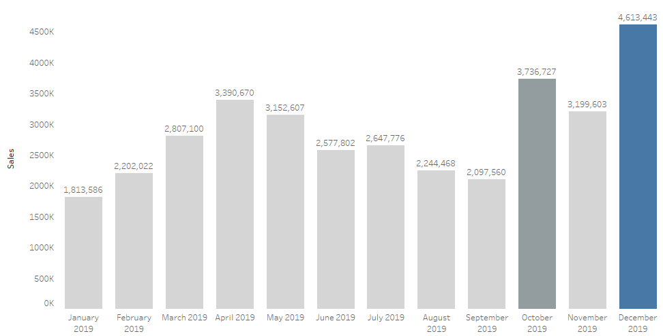
Highest sales for twelve months($)
December seems to be the best month for sales.
Sales is lowest in January.
After six months of drop in sales, there was a sharp rise in sales in October.

Slide 4
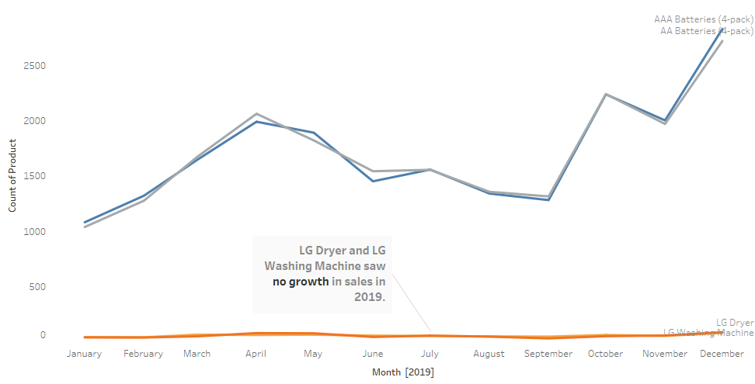
Most and least sold product trend
Sales of AAA Batteries(4-pack) and AA Batteries(4-pack), seems to be in similar trend.
The LG Dryer and LG Washing Machines had almost no growth trend all through the year.

Slide 5
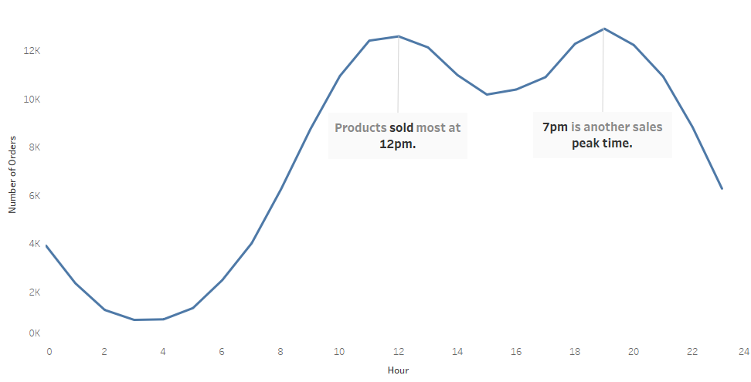
Hour with most sales
Daily sales pick up by 7am.
The best times of the day for sales are 12pm and 7pm.
Sales seems to drop by 3pm.

Slide 6
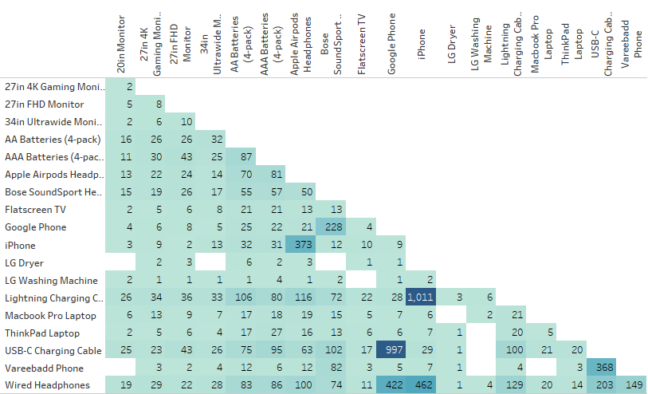
Two items frequently sold together
Lighting charging cable and iPhone are the two items most frequently bought together(1,011 times).
Google phone and USB-C Charging cable are the second most frequently bought together(997 times).
Other pairs frequently bought together are: Google phone/Wired headphones, iPhone/Wired headphones.
Phone/Charging cable and Phone/Headphones pairs seem to be bought together.

Slide 7
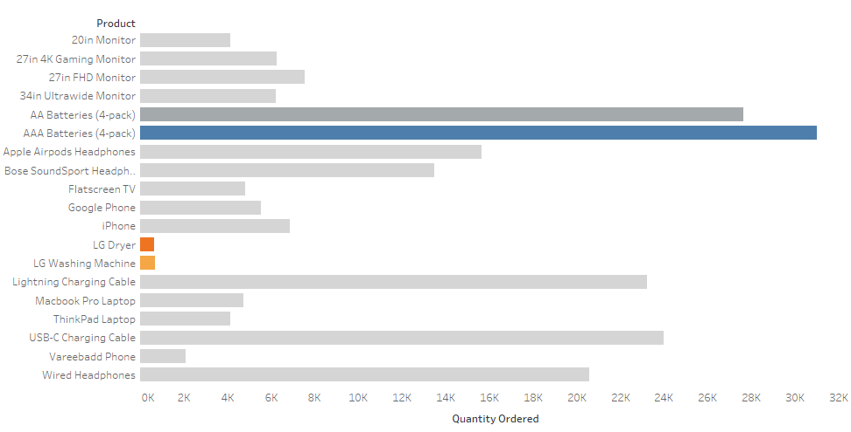
Product that sold the most
AAA Batteries(4-pack) followed by AA Batteries(4-pack), sold the most.
Other items with high sales are: Lighting Charging Cable, USB-C Charging cable.
LG Dryer and LG Washing Machine saw the least number of sales.

Slide 8
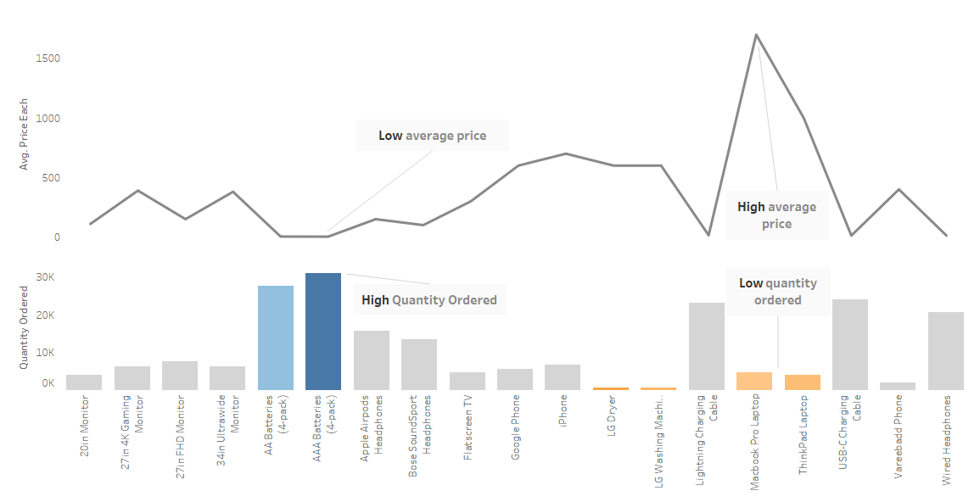
How price affects quantity ordered
Low average price seems to generate high quantity ordered.
High average price seems to generate low quantity ordered.

Slide 9
Recommendations
Good publicity and promotions should begin in November to maximize the high sales in December.
The sharp rise in sales in October need to be investigated. A clue to increasing sales might come from the investigation.
Further investigation is required to know why the LG Dryer and LG Washing Machines had almost no growth trend all through the year.
Daily advertising should begin at 11:45am and 6:45pm daily.
Certain products should be placed close to each other to increase sales.

Slide 10
Recommendations
Most bought items such as the AAA Batteries(4-pack) and AA Batteries(4-pack) should never run out of stock.
Phone/charger and phone/headphone pairs should always be placed close to each other.
There is need for price reduction for some products such as MacBook Pro laptop and ThinkPad laptop, to help increase sales of those items.

